Slide 1
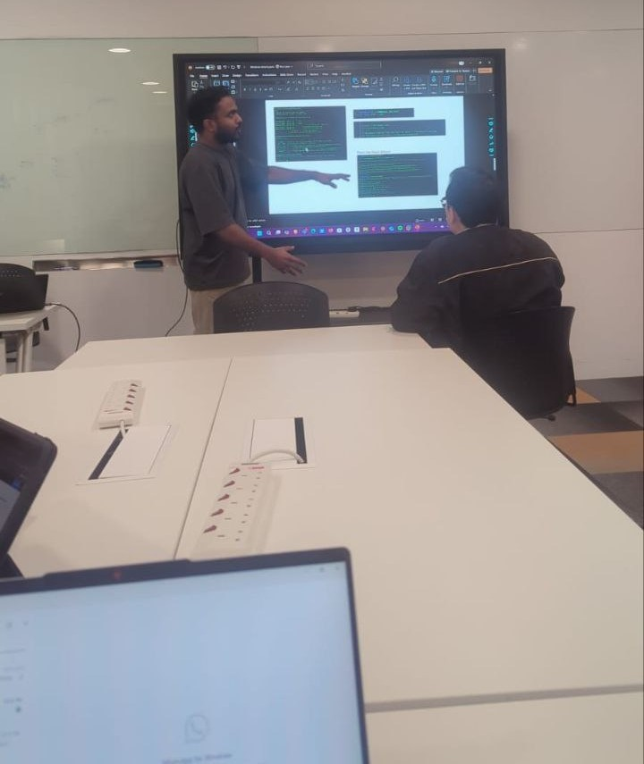
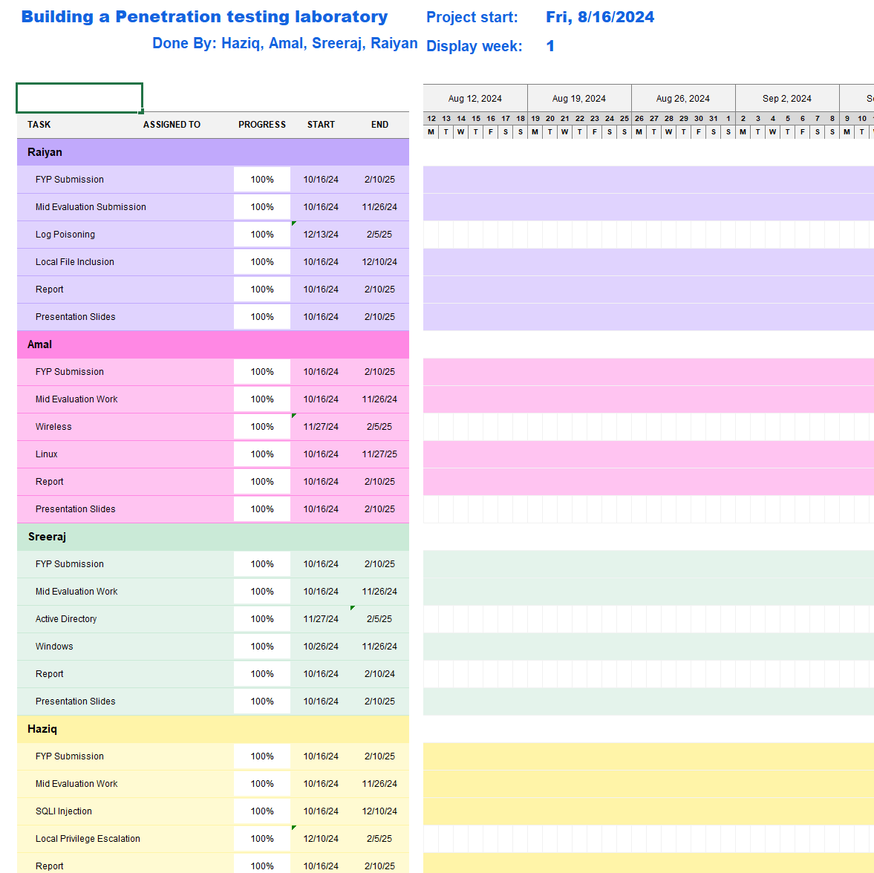
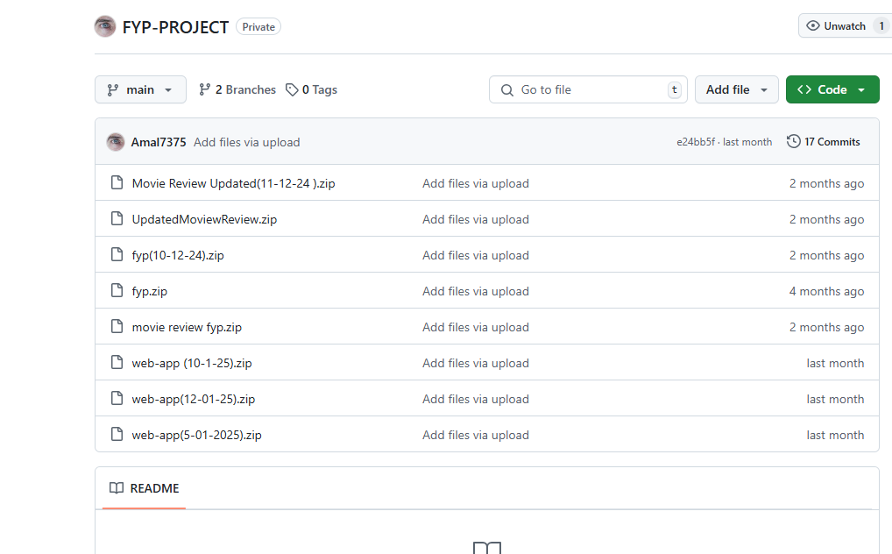
Building a Penetration testing laboratory
Project Overview
Problem: Cyberattacks are increasing in frequency and sophistication, targeting governments and companies through various attack vectors (e.g., networks, websites, malicious insiders). Singapore faces a critical shortage of IT security professionals, which leaves the nation vulnerable to cyber threats.
Additionally, the lack of practical training environments for ethical hacking and penetration testing makes it difficult for aspiring cybersecurity professionals to develop hands-on skills.
Requirements:
Provide an interactive and controlled penetration-testing lab for cybersecurity training.
Allow students and IT practitioners to simulate real-world attacks in a safe environment.
Enable hands-on experience in ethical hacking and cyber defense techniques.
Be scalable, secure, and easily maintainable for future users.
Solution:This project aims to design and implement a penetration-testing lab that provides a controlled, hands-on environment for ethical hacking training. The lab will simulate real-world cyberattack scenarios, allowing students to develop offensive cybersecurity skills through practical exercises. It will include security challenges such as web vulnerabilities, network exploits, Linux and windows vulnerabilities, enabling users to hone their penetration testing techniques.
Technologies:
Virtualization Platforms: VMware
Operating Systems: Kali Linux, Windows Server, Ubuntu.
Penetration Testing Tools: Metasploit, Nmap, Burp Suite, Aircrack-ng, etc.
Scripting & Automation: Python, Bash.
Gantt chart
Weekly meeting
Git hub Repository
Team Members
Amal (22008187), Raiyan (22009471) ,Sreeraj (22007491),
Haziq (22017858)
Mr. Edmond Khoo (supervisor)
Notes:
NOTES
Refer to write ups in ‘Past Projects for Reference’ Booklet for Project overview write ups - http://yoda.soi.rp.edu.sg/wiki/index.php/FYP_Wiki
ENGLISH - British E.g. organisation VS organization
Font: RP approved font - Arial family only.
Header: Arial Bold
Copy text: Arial regular or Arial Bold. Use Emphasis of our SOI orange in moderation.
Picture frame – Give a 4.5 or 6pt orange outline.

